Slide 1




DATE: August 31, 2024
A SESSION ON
GIT
AND GITHUB
PRESENTED BY:RAJAN BHANDARI

Slide 2
PRESENTED BY:RAJAN BHANDARI
History:
Initially, the Linux kernel was developed without using any version control system (VCS). In 2002, the Linux project started using BitKeeper, a proprietary VCS, which was provided free of charge to open-source developers.
However, in 2005, the free status was revoked, leading Linus Torvalds (developer of Linux Kernel) to create Git as an open-source alternative.
BitKeeper is a proprietary distributed version control system that was used by the Linux kernel project before Git was created.
A proprietary VCS is a version control system owned by a company, where the source code is closed and users must follow specific licensing terms, often involving costs. Unlike open-source VCS, users can't freely modify or distribute the software.

Slide 3


PRESENTED BY:RAJAN BHANDARI
WHAT VCS REALLY IS ?
It is a software tool that helps to manage the source code allowing multiple developers to work on a project simultaneously and keep track of different
versions of the code.
Examples are:

Slide 4
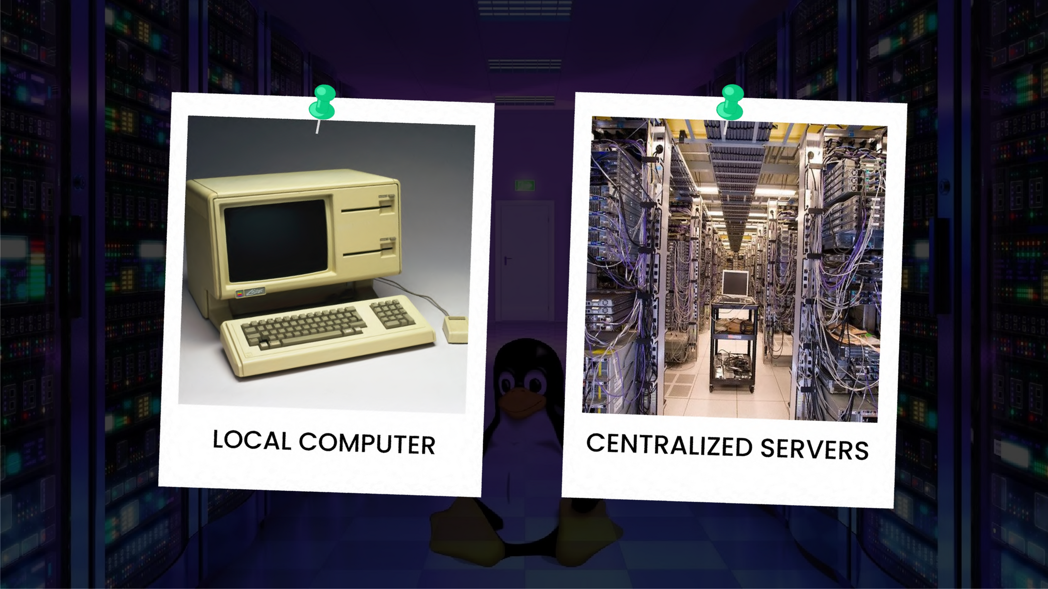
PRESENTED BY:RAJAN BHANDARI

Slide 5
PRESENTED BY:RAJAN BHANDARI
Let’s Understand the Problem:
You are a developer and you are working in a big project where multiple developers works together. In this case, how do you send and receive the codes with each other?

Slide 6
PRESENTED BY:RAJAN BHANDARI
We try to send our codes through email, Facebook, Messenger, and Telegram, etc.

Slide 7
PRESENTED BY:RAJAN BHANDARI
But what if there are hundreds or thousands of lines of code?
What if you want to track who changed your existing code?
What if you need to collaborate with multiple people and keep everyone’s changes organized?
What if you want to go back to a previous version of your project after making a mistake?

Slide 8
PRESENTED BY:RAJAN BHANDARI
Simply,
How you and your Friend can work in a same project Remotely?

Slide 9
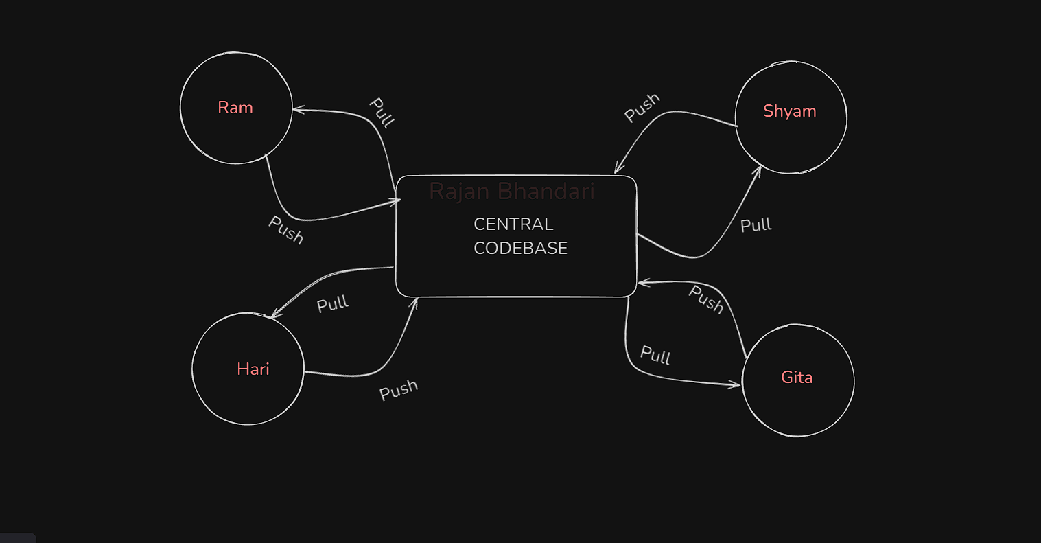
PRESENTED BY:RAJAN BHANDARI
And here we have github:

Slide 10
PRESENTED BY:RAJAN BHANDARI
What is Git?
A tool that helps you track changes in your
code, allowing you to go back to previous versions.
Manages your code locally.
It allows us to create different versions of your project.
Allows us to go back to previous versions.
Allows us to make checkpoints.

Slide 11
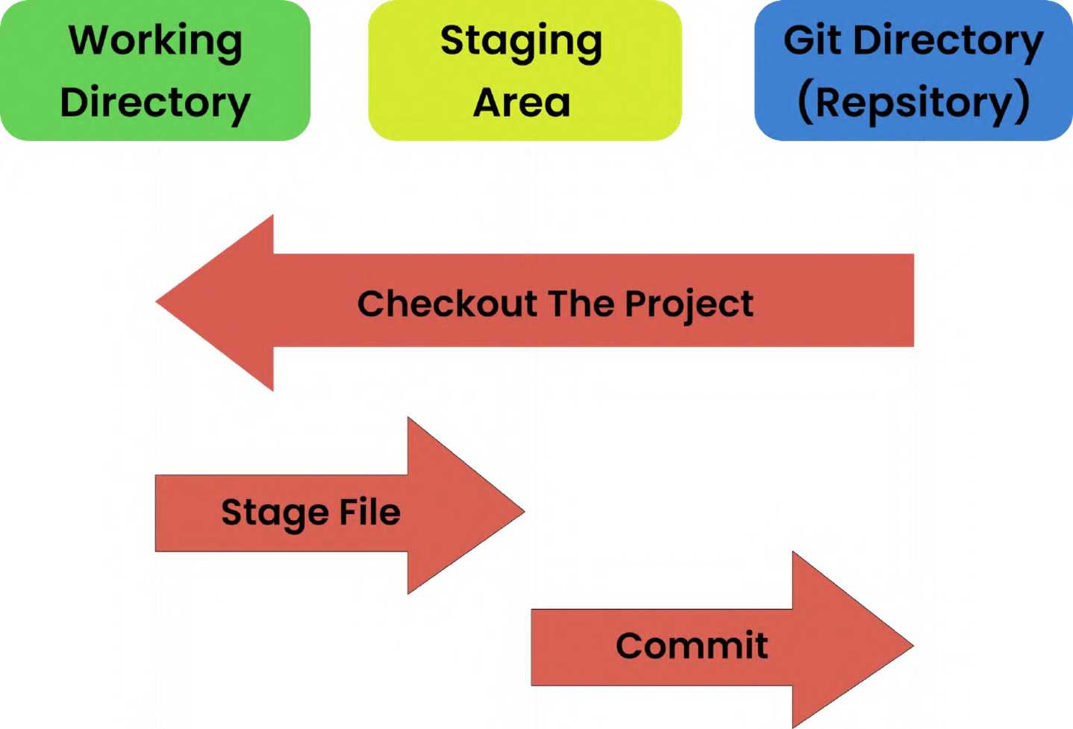
PRESENTED BY:RAJAN BHANDARI
Git -Three Stage Architecture:

Slide 12
PRESENTED BY:RAJAN BHANDARI
What is GitHub?
An online platform where you can store and share your Git projects, host your projects, making it easy to collaborate with others and manage your code in the internet.

Slide 13
PRESENTED BY:RAJAN BHANDARI
Installation of Git:
For Git = https://git-scm.com/downloads
Open command Prompt and type ”git”.
If success, you see a window with common Git Commands like:
usage, clone, init, add, mv, restore, rm etc.

Slide 14

PRESENTED BY:RAJAN BHANDARI
Installation of VScode:
https://code.visualstudio.com/download

Slide 15
PRESENTED BY:RAJAN BHANDARI
Recommended Extensions:
Git Blame(tells us that who, when and what modified the code)
git-autoconfig (optional)
Git graph

Slide 16
PRESENTED BY:RAJAN BHANDARI
Configuring Github Globally:
These commands set up your name, email, editor, and line-ending preferences in Git, so it knows who you are and how to handle files.
git config --global user.name "mickey4541"
git config --global user.email "rajanbhandari4541@gmail.com"
git config --global core.editor "code --wait"
git config --global core.autocrlf "input"
git config --global -e => to edit the code

Slide 17
PRESENTED BY:RAJAN BHANDARI
The command git config --global core.autocrlf "input" ley mac ra windows maa code ko line ending hune tarikaa different hunxa. So, mac ko code windows maa aauda windows aanusar change hunu paryo and vice versa. This helps keep line endings consistent across different systems.
When git face problems on code, it automatically opens the vs code editor for the debugging or code editing.
“wait” ko matlab terminal maa ma wait garirako xu jabasamma user ley tyo code end gardaina yaa code edit garera vs code close gardaina taba samma wait garxu vaneko

Slide 18
PRESENTED BY:RAJAN BHANDARI
Terminologies you need to know:
U = Untracked (git doesn’t know the file currently.)
A = Added or Staged (Now, git know the file.)
C = Committed (Now git is tracking the file/making a checkpoint)
M = Modified.

Slide 19
PRESENTED BY:RAJAN BHANDARI
Now let’s check it how it works:
First, make a file and initialize it by clicking on Source control icon in vs code.
make index.html file and readme.md file.
write only one line of code first and commit it. Repeat it three times. Now, there are three saved points.(checkpoints.)

Slide 20
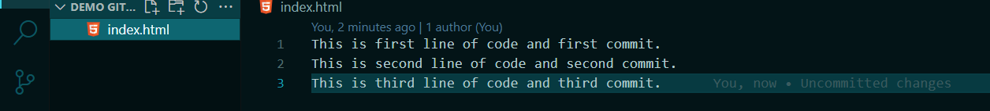
PRESENTED BY:RAJAN BHANDARI
git log --oneline => to know the current status of the saved points(checkpoints). To check this:
Here, i have made a file index.html and write 3 line of code. Each line was committed one line at a time creating a three checkpoints.

Slide 21
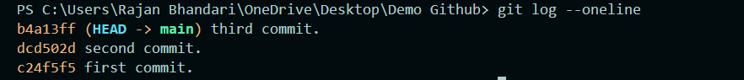
PRESENTED BY:RAJAN BHANDARI
After typing the git log --oneline in Terminal, we see this result.
Head -> main means we are currently in third commit.
Here, b4a13ff in the figure is the unique id. Using this id, we can go in our any checkpoints.

Slide 22
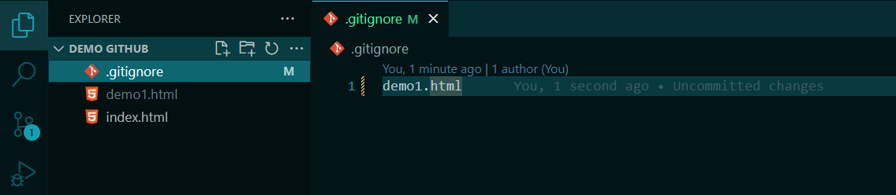
PRESENTED BY:RAJAN BHANDARI
.gitignore:
If you want to untrack any of the file, you can use .gitignore.

Slide 23
PRESENTED BY:RAJAN BHANDARI
Going back to some previous saved points:
Soft
Hard
Mixed
git reset --hard HEAD~1
Head~1 means go to one step back checkpoint.

Slide 24
PRESENTED BY:RAJAN BHANDARI
git reset --soft HEAD~1: Undo the last commit but keep the changes staged, allowing you to create a new commit.
git reset --mixed HEAD~1: Undo the last commit and unstage the changes, but keep them in your working directory so you can modify them.
git reset --hard HEAD~1: Undo the last commit and completely discard all changes in your working directory and staging area.

Slide 25
PRESENTED BY:RAJAN BHANDARI
To check the status of the file.
If we want to see which file is in which status , means untracked, added, modified, => we can do:
git status -s
Note:
Git status -s only tells the status of those files which are not committed and those files which are modified after committed.

Slide 26
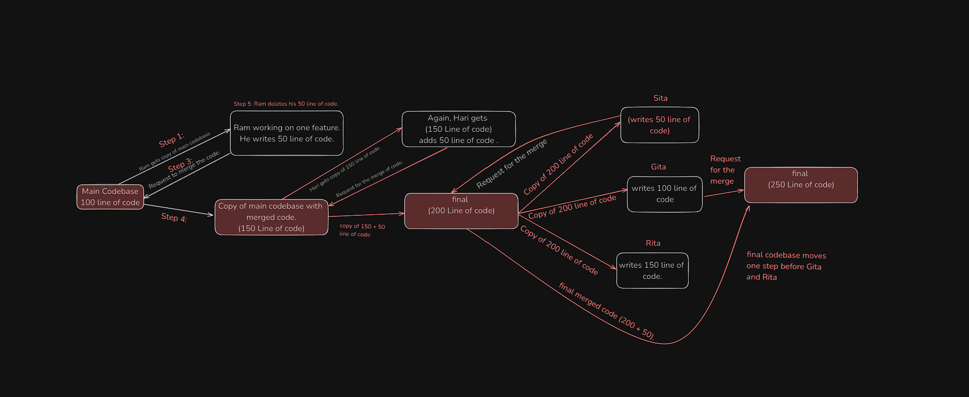
PRESENTED BY:RAJAN BHANDARI
Branching:

Slide 27
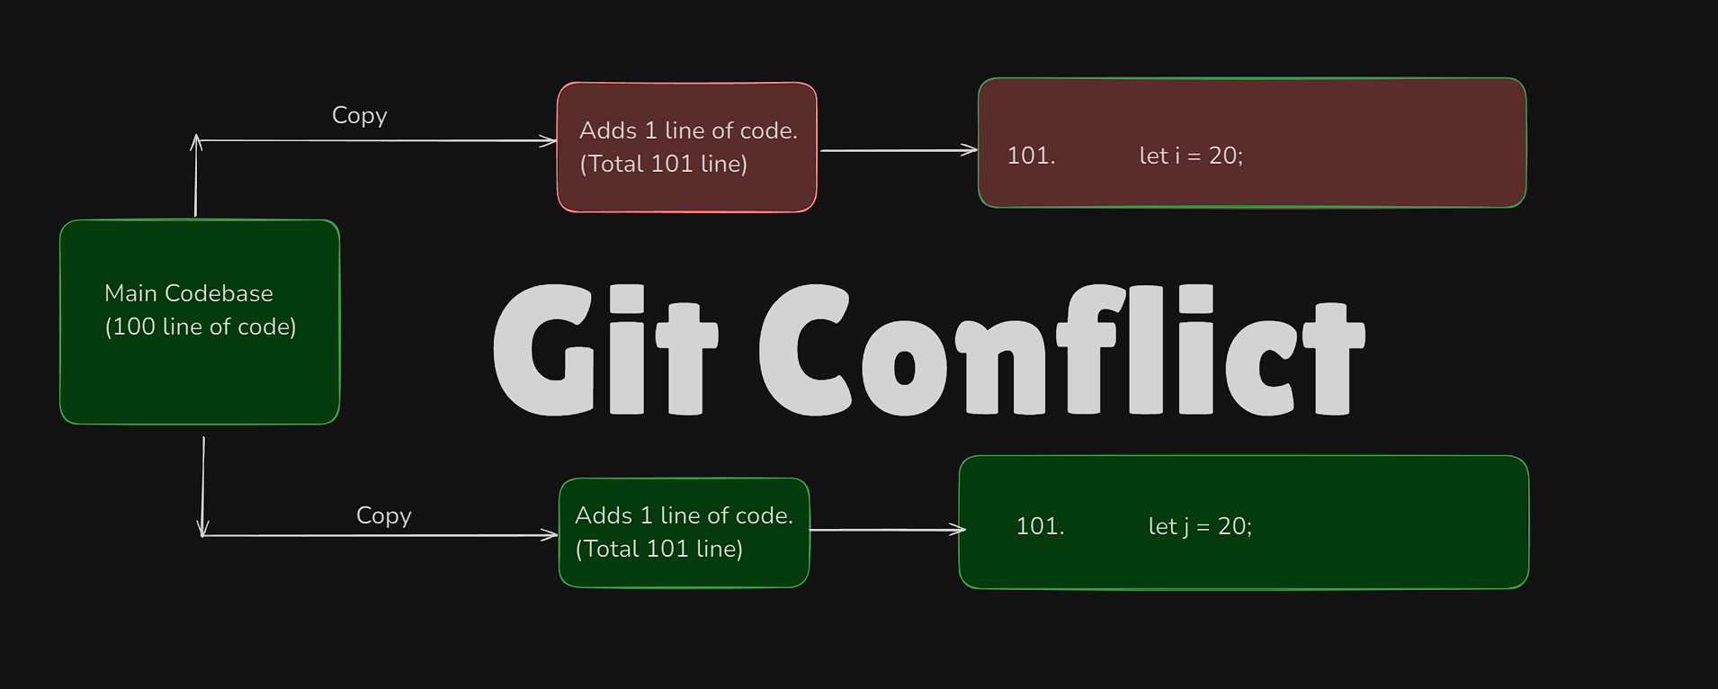
PRESENTED BY:RAJAN BHANDARI
Git Conflict:

Slide 28
PRESENTED BY:RAJAN BHANDARI
In the case of conflict, git gives us three choices:
Choose option 1.
Choose option 2.
Choose both option 1 and 2.

Slide 29
PRESENTED BY:RAJAN BHANDARI
Making branches:
To make new branch:
git branch (branch_name) => feature/navbar.
To see all branches:
git branch
To Switch between branches:
git switch feature/navbar
To delete branch:
git branch -d feature/navbar

Slide 30
PRESENTED BY:RAJAN BHANDARI
make a branch feature/navbar.(git branch feature/navbar).
write one line code in main branch and commit.
Write one line code in feature/navbar and commit.
Now see the changes by:
git branch
git switch feature/navbar
git switch main

Slide 31
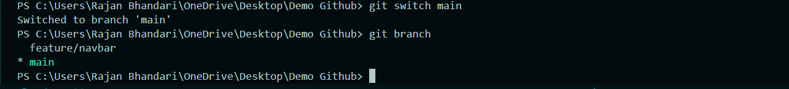
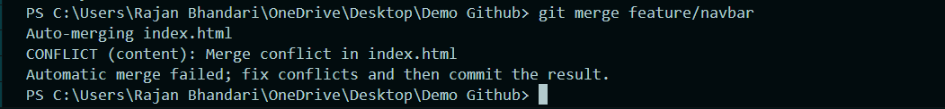
PRESENTED BY:RAJAN BHANDARI
Merging Branches:
Note:To merge the branches, we have to be in main branch first.
Now, merge the code
Here, we are in conflict.

Slide 32
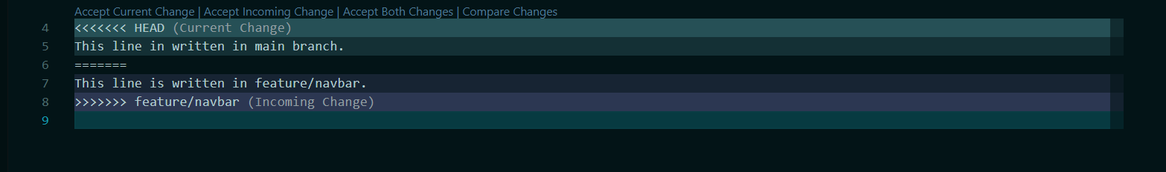
PRESENTED BY:RAJAN BHANDARI
This is what we see on interface.
Accept one of these three changes.
Then, add by clicking (+) and commit the merge process.

Slide 33
PRESENTED BY:RAJAN BHANDARI
Points to Remember:
We cannot switch between branches without completing the process of merging.
Always make sure that you are in main branch while merging the code.
If there are different code in same line, we face conflict.
If there is same code in same line, it doesn’t affect.
Different code in different line, it doesn’t affect.
same code in different line doesn’t affect. "Same code on different lines usually doesn't cause conflicts unless nearby changes interfere."

Slide 34
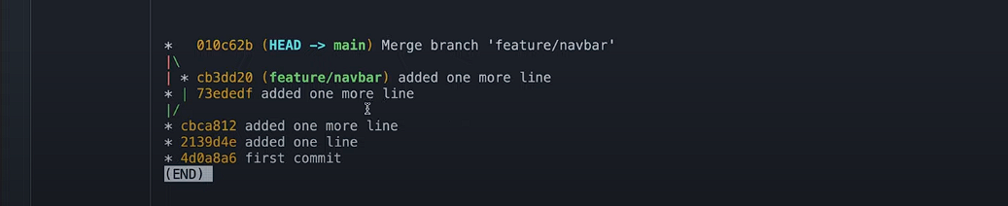
PRESENTED BY:RAJAN BHANDARI
To See detailed log:
git log --oneline --graph
git log: Shows the commit logs (history of commits).
--oneline: Displays each commit on a single line, showing the commit hash and the commit message.
--graph: Displays an ASCII graph of the branch and merge history.

Slide 35
PRESENTED BY:RAJAN BHANDARI
Merging Techniques:
Fast Forward Merging
Three way merging
Squash Merging
Recursive Strategy Merging
Rebase and Merging
Most used are FF merge and threeway merge. We are going to learn these two techniques.

Slide 36
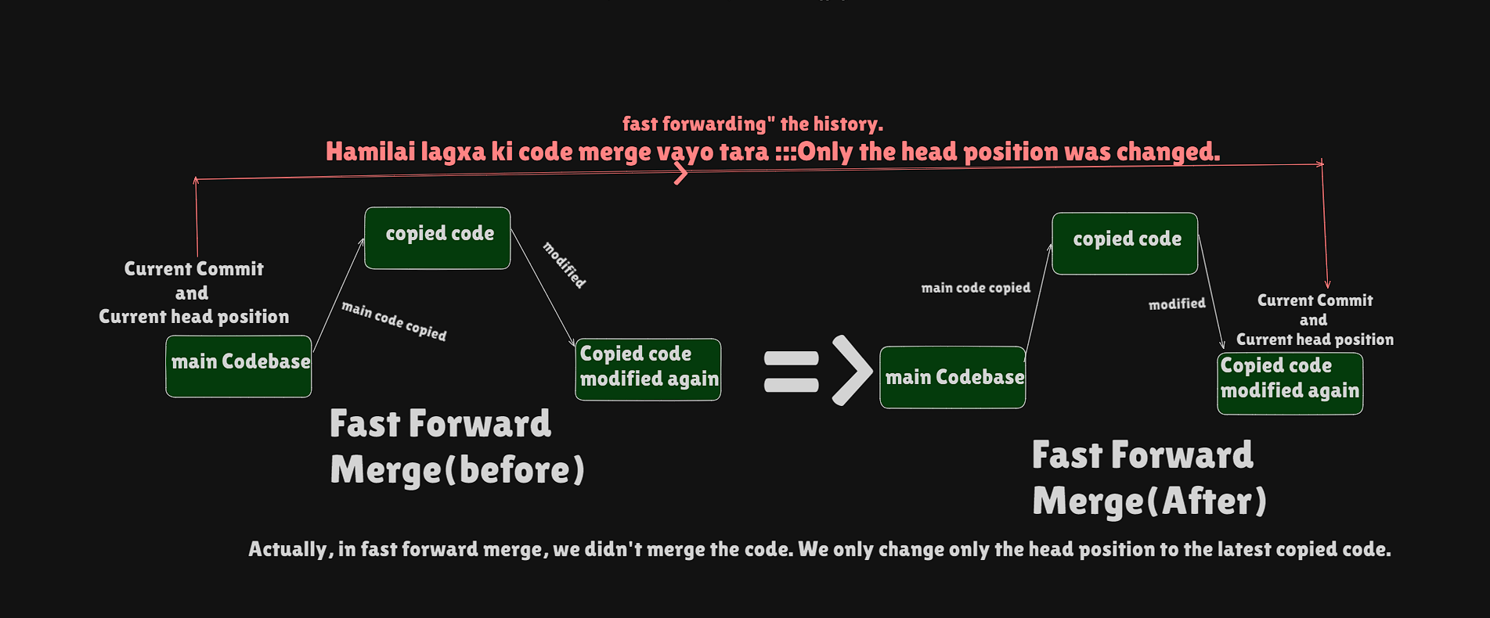
PRESENTED BY:RAJAN BHANDARI

Slide 37
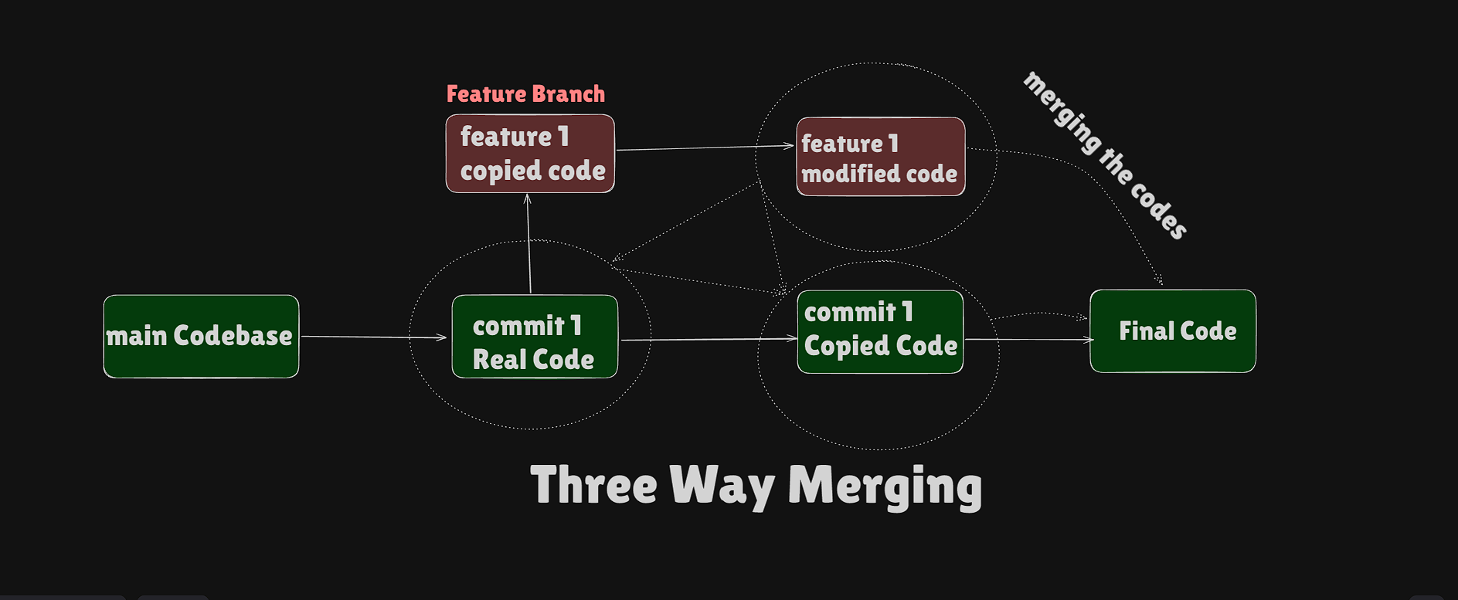
PRESENTED BY:RAJAN BHANDARI
"In a three-way merge, as shown in the image, Git uses the common ancestor (commit 1 Real Code), the current branch (feature 1 modified code), and the merging branch (commit 1 Copied Code) to combine changes from different branches, resulting in the Final Code."

Slide 38
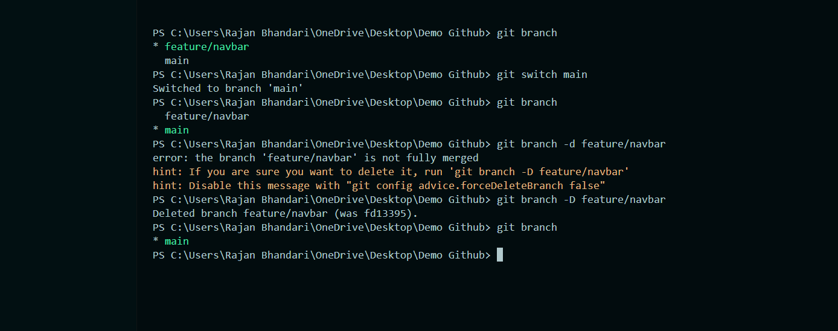
PRESENTED BY:RAJAN BHANDARI
Deleting a branch:

Slide 39
PRESENTED BY:RAJAN BHANDARI
Stashing:
"When you are working on any branch and have written some code but haven't committed it, and you try to switch to another branch, Git tells you that the changes aren't saved and might get deleted.
We can either delete those changes or save them as a draft (stash them). When you stash the changes, they won't be deleted or added, but they will be stored somewhere.
Later, when you come back to that branch, you can reapply those changes."

Slide 40
PRESENTED BY:RAJAN BHANDARI
To create and switch branch at once: git switch -C feature/footer
Let’s do stashing:
first create a branch and switch by writting above command.
let’s say we make feature/footer branch.
switch to main branch : git switch main
Inside main, write a code, add and commit it.
Again, switch the branch : git switch feature/footer.
Write a code into feature/footer and add and commit it.

Slide 41
PRESENTED BY:RAJAN BHANDARI
now switch to main : git switch main
Again write another line into main and do not add or commit it.
Now, try switching the branch::::::::
Here we got the error saying that: please commit your changes or stash them before you switch branches.
Now, we have to commit or stash our code to switch to another branch.
for this: git stash
your code is now stashed, you can switch to feature/footer.

Slide 42
PRESENTED BY:RAJAN BHANDARI
Again switch branch from feature/footer to main: git switch main
Here, we have to get back our stashed code:
git stash apply
Then, git stash clear to delete the stash.
Then, we got our stashed code and we can now add and commit our code.

Slide 43
PRESENTED BY:RAJAN BHANDARI
Collaboration :
Key points to remember:
1. Captain makes folders and all the initial files.
2. Captain upload the files in github.
3. Captain add the collaborators.
4. Collaborators clone the repo into their local environment.
5. Imp: Collaborators create their seperate branch.
6. Collaborators write codes in their seperate branch.
7. Collaborators completes coding and they commit and push code in github.
8.Collaborators inform the captain that they push the code in github.
9. Captain then fetch the code pushed by collaborators and captain checks the code and re-push the code into main folder.

Slide 44
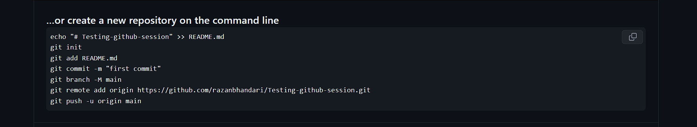
PRESENTED BY:RAJAN BHANDARI
Let’s make initial folder and files:
open folder in vs code and make index.html, style.css and script.js
Write boiler plate code in html, css and js.
Go to github.com and make one repo and click create repository. Here, we can see bunch of code.

Slide 45
PRESENTED BY:RAJAN BHANDARI
4. Open terminal in vs code, copy the code and run each line of code one by one.
Note: git add README.md replace by git add . => to add all the files.
Now, inside your recently uploaded file in github, click on setting and then collaborators.
Invite collaborators using their email or username.
Collaborator check the mail and accept the invitation.

Slide 46
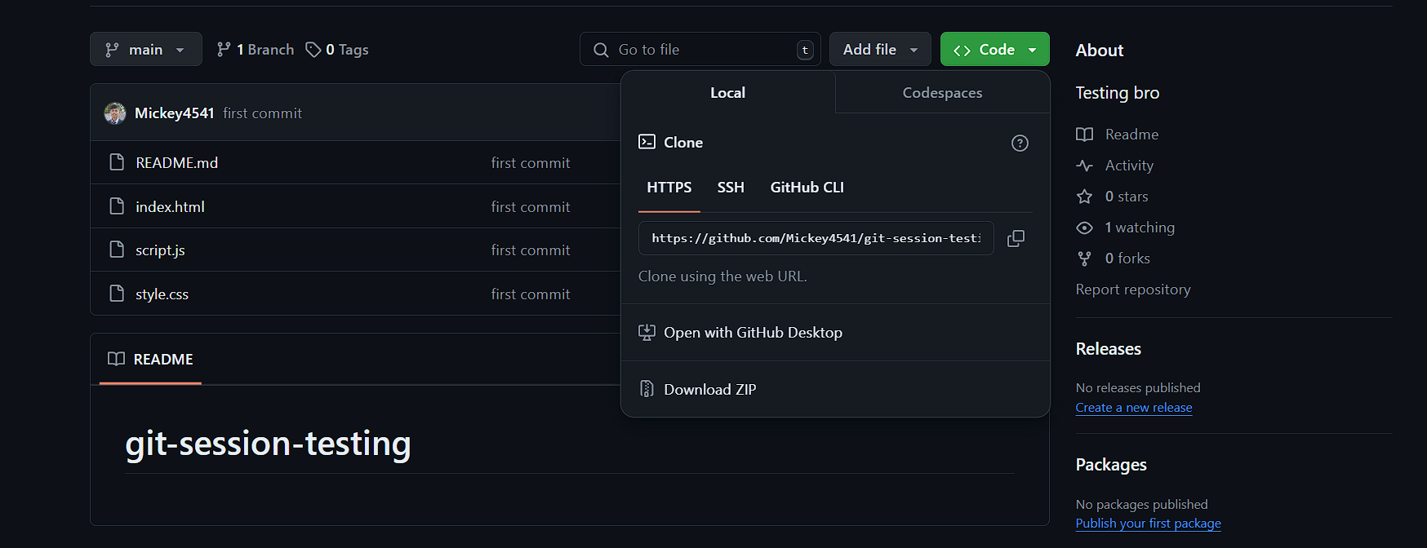
PRESENTED BY:RAJAN BHANDARI
Now , for collaborators:::
After accepting invitation, click on green code button shown in figure and copy the url.

Slide 47
PRESENTED BY:RAJAN BHANDARI
Now , for collaborators:::
Then, collaborators open the vs code, open the folder in vs code and then opens a terminal. (Only open the folder, don’t make index.html, style.css and other file).
After this, write the code in terminal:
git clone (https://github.com/Mickey4541/git-session-testing.git)(git clone paste url).
IMPORTANT:
REPO clone garisake paxi collaborator ley jhukiyera pani code lekhnu vayena. First, make a seperate branch and work only on that branch.
For this: First do cd folder_name(if any error happens, otherwise skip).
git switch -C feature/animation

Slide 48
PRESENTED BY:RAJAN BHANDARI
You can check by git branch to see the active branch.
Now collaborators only write code in that recently made branch. When collaborators completes coding, he/she commit the changes and push the code. Make sure you only work on branch and you active in that recently made branch. Code can be committed and pushed by:
git add .
git commit -m “commit message”
Here, collaborate made checkpoint in his local environment, not in github.

Slide 49
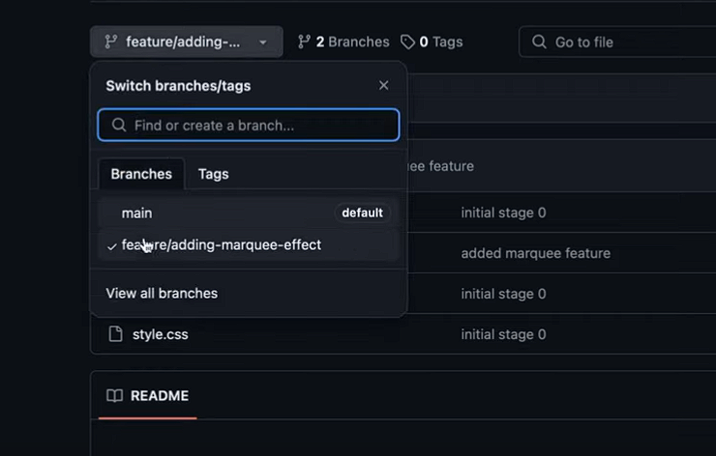
PRESENTED BY:RAJAN BHANDARI
Now, collaborator uploads that file in github by:
git push -u origin “feature/animation”.
Open github and we can see that there is a recently added branch.
Note that the main codebase is not changed till now.

Slide 50
PRESENTED BY:RAJAN BHANDARI
Then, that collaborator inform captain that he successfully push the code in github. check it out.
Now , for Captain:::
He opens the vs code and first he run the command.
git fetch => result shown as {new branch (branch_name) }
-git branch
-git switch (branch_name)
Here, captain can see or switch to the branch which was recently pushed by the collaborator.

Slide 51
PRESENTED BY:RAJAN BHANDARI
Captain switched to that recently pushed branch and see the code if it is correct or not. If the code is correct:
-git switch main
-git merge (branch_name)
Here captain merge the collaborator code into the main code in his local environment. Captain again push code into the github by:
-git push origin main

Slide 52
PRESENTED BY:RAJAN BHANDARI
Now, the merged code is with captain and github but not with collaborator.
Captain again inform the collaborator that the code is merged into central codebase.
Now , for Collaborator:::
collaborator perform :
-git switch main
-git fetch( We have to perform merge by : -git merge branch_name)
-git pull(fetch and merge at once)

Slide 53
PRESENTED BY:RAJAN BHANDARI
Git Rebase:
Git rebase is a command that allows us to move the starting point of our branch to a new base, aligning it with the latest commits from another branch. This keeps our branch updated and makes the project history cleaner.
Let’s understand it more clearly from the figure:

Slide 54
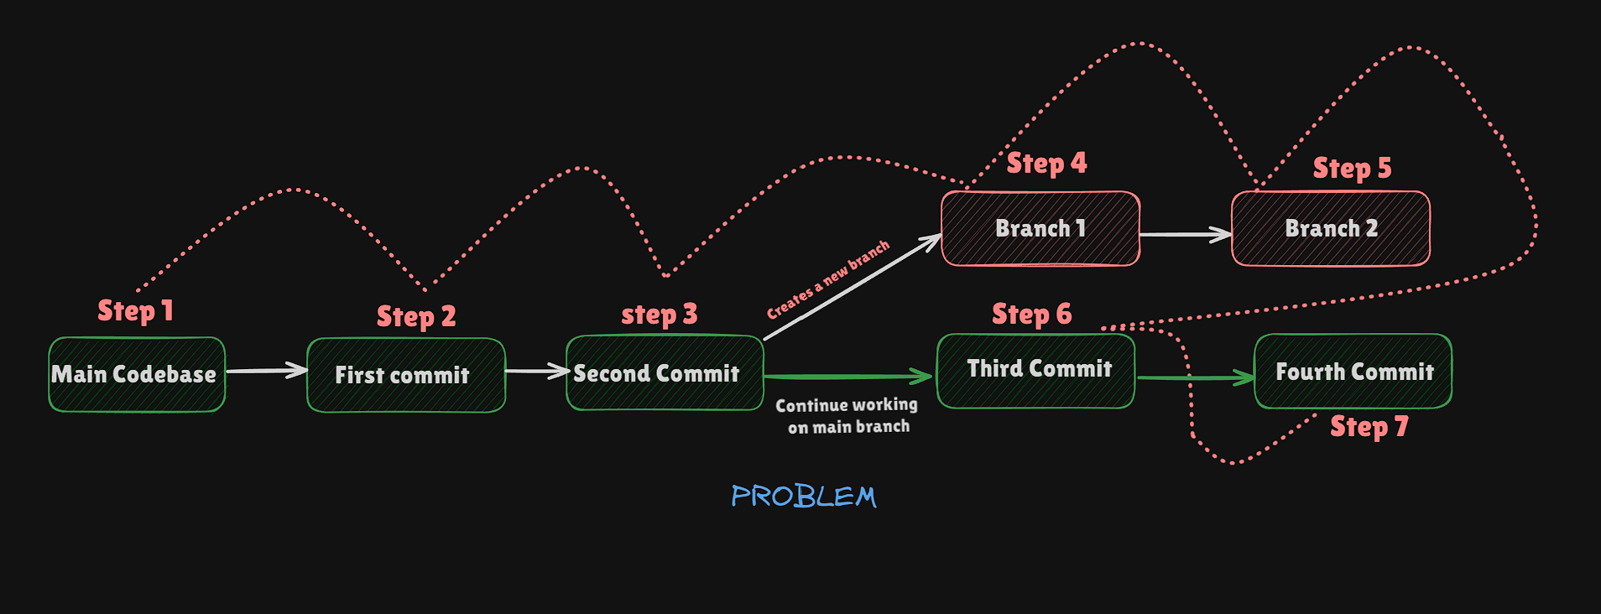
PRESENTED BY:RAJAN BHANDARI
Git Rebase:

Slide 55
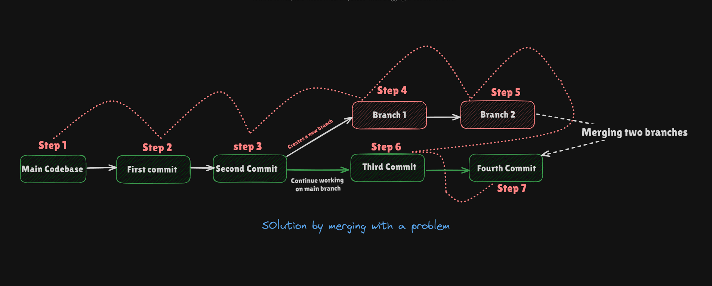
PRESENTED BY:RAJAN BHANDARI
Can we do it by merging the branches?:

Slide 56
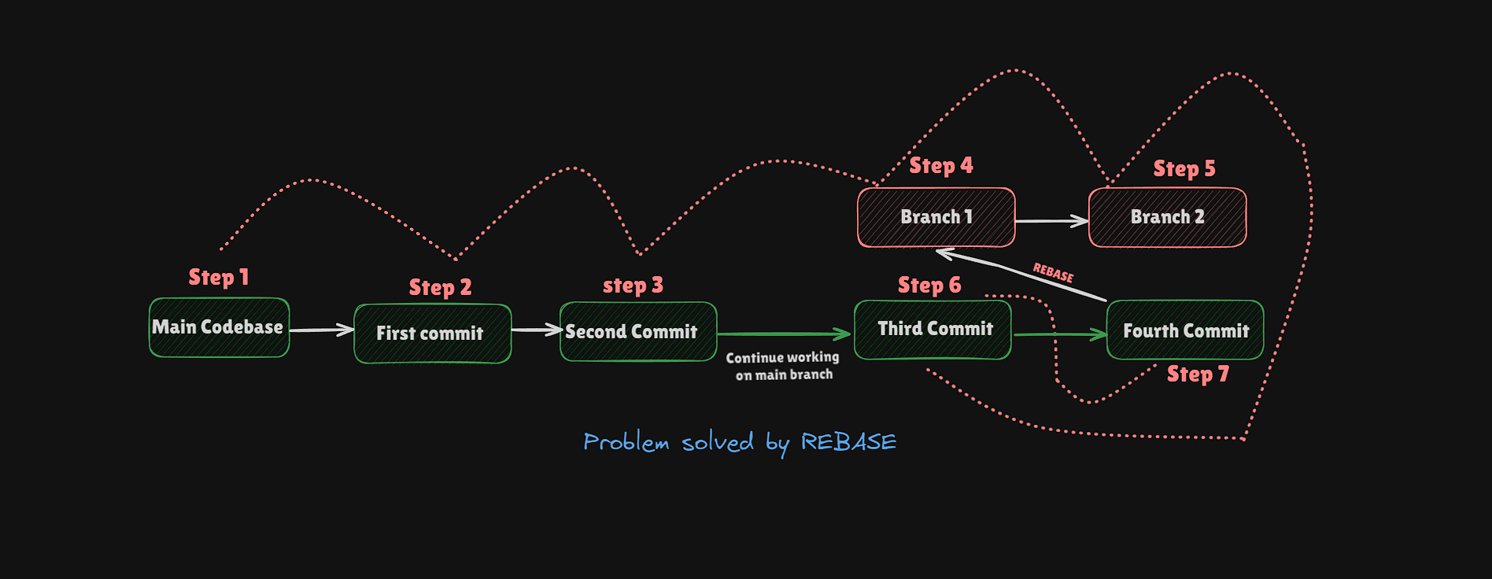
PRESENTED BY:RAJAN BHANDARI
Solution by Rebase:

Slide 57
PRESENTED BY:RAJAN BHANDARI
Let’s do Rebase:
Init one folder, make a file and write code , commit it 2 times
First, check the current branch: => git branch
Make a new branch.=> git switch –c feature/copyright
Verify it again => git branch
Now you are in feature/copyright branch. Now, make a file write some code.
Add the code by: => git add demo.html
Commit it => git commit –m “Copyright committed successfully”
Here we made a separate branch and work on that branch…..

Slide 58
PRESENTED BY:RAJAN BHANDARI
Let’s do Rebase:
Before merging the feature/copyright to a main branch, some of our collaborator start working on the main branch…..
Switch to main branch : git switch main ||| -git checkout main
Inside main, Again write one line of code and add and commit it.
-git add index.html
-git commit –m “fixes added for the copyright in index”

Slide 59
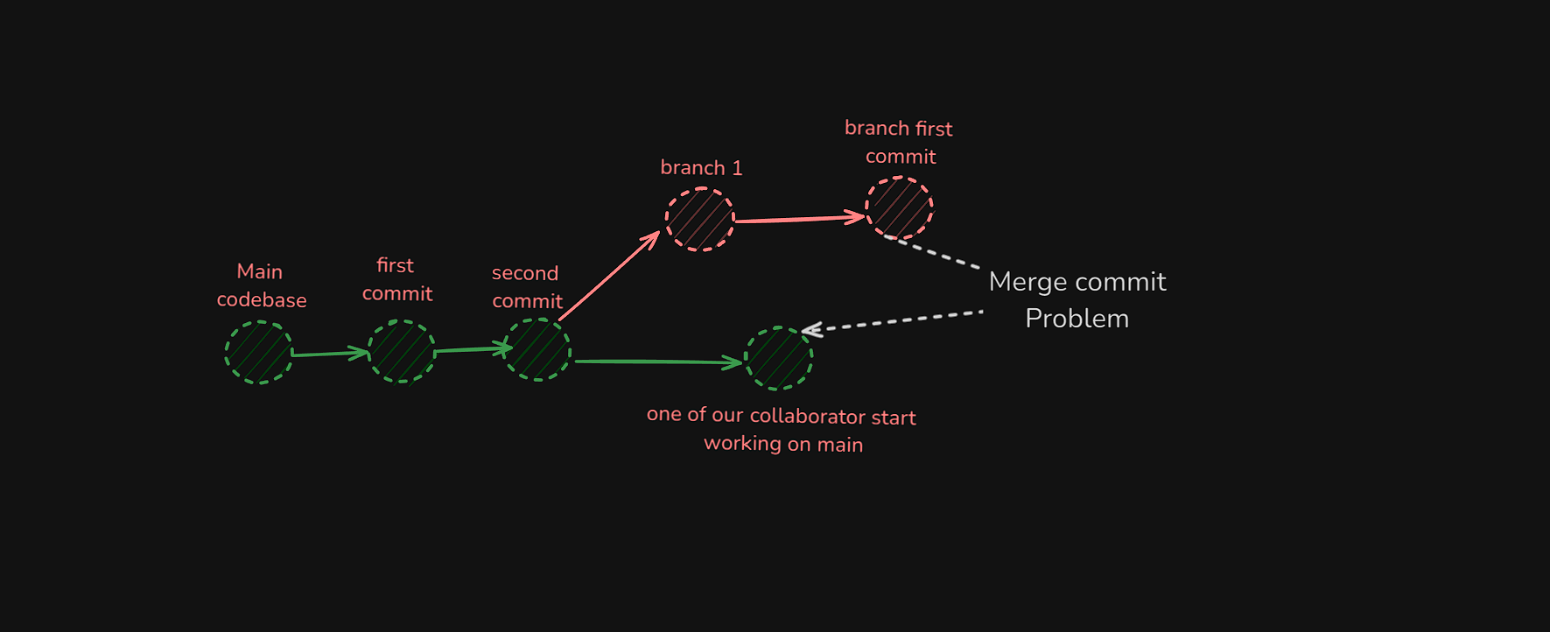
PRESENTED BY:RAJAN BHANDARI
Here, we have done::
Make a folder and commit it two times.
Created a branch and work on that branch.
Again, we came back to main branch and added fixes and committed it.
Switched to feature/copyright and merge the master: git merge master

Slide 60
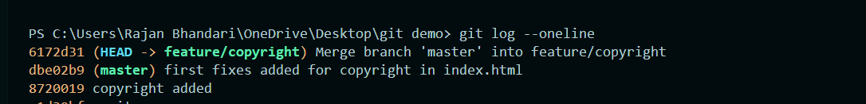
PRESENTED BY:RAJAN BHANDARI
The commit message 6172d31 pollute the commit because we got one extra merge commit. It has no usage at all. So, Rebase was designed to fix this merge commit.
Note: Ensure that you are on that branch you want to rebase.

Slide 61
PRESENTED BY:RAJAN BHANDARI
Repeat the scenario:
-git checkout master
git branch
git switch –c feature/nav
Check the branch: git branch
You are in nav branch. Make a file nav.html and write code inside it.
Add and commit it: - git add nav.html - git commit –m “nav branch committed.”
Then, switch to master/main branch: git checkout master.
Add some code in main/master branch file and add and commit it.

Slide 62
PRESENTED BY:RAJAN BHANDARI
To rebase:
git checkout feature/nav
Check the current branch: -git branch
git rebase master/main
git log –oneline => checking commit and there is no extra commit.
Note: Ensure that you are on that branch you want to rebase.

Slide 63
PRESENTED BY:RAJAN BHANDARI
Handling conflict in Rebase:
How can we handle conflict in Rebase?
=> Exactly like we handle the conflict in Merging.

Slide 64
PRESENTED BY:RAJAN BHANDARI
Open Source Contribution perspective:
The source code is freely available for anyone to use, modify, and distribute.
participating in the development,
improvement, or
maintenance of open-source projects
writing code,
fixing bugs,
adding features,
improving documentation,
helping with community support.

Slide 65
PRESENTED BY:RAJAN BHANDARI
How to make github profile professional?
Adding Readme.md file and editing it with various components.
https://rahuldkjain.github.io/gh-profile-readme-generator/

Slide 66
PRESENTED BY:RAJAN BHANDARI
Github Pages:
A free hosting service provided by GitHub that allows you to publish web content directly from a GitHub repository. It's often used for hosting project documentation, personal blogs, or portfolios.
Ok Let’s host our website on Github using github pages.

Slide 67
PRESENTED BY:RAJAN BHANDARI
Extras:
WHAT IF I MISTAKENLY DO "GIT ADD ."?
-git restore --staged file_name
-git reset file_name
-git reset (to remove all from staging area)
WHAT IF I MISTAKENLY WRITE THE WRONGCOMMIT?
-git commit –amend –m “new_message"
WHAT IF I MISTAKENLY DELETE/MODIFY THE CONTENT INSIDE MYCODE?
-git checkout --file_name
-git checkout .
-git checkout -f

Slide 68
PRESENTED BY:RAJAN BHANDARI
Extras:
Deleting/Removing and moving and renaming file:
-git rm filename
-git mv filename new_filename
That’s it !!!

Slide 69
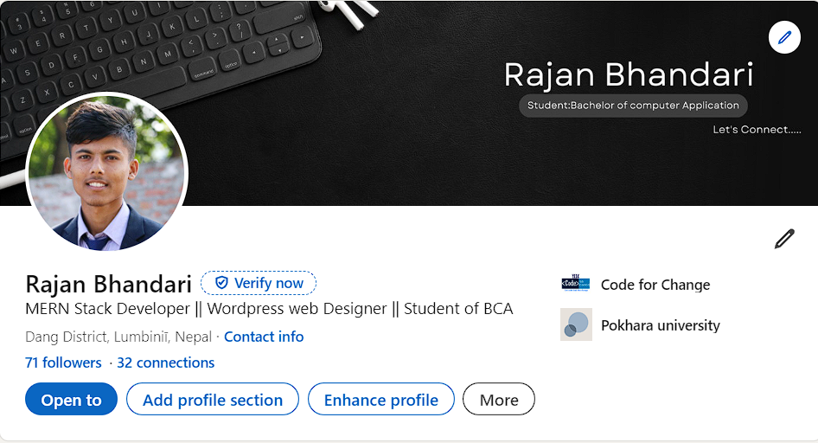
CONNECT WITH ME:

Slide 70
THANK
YOU
THANK
YOU
❤️

